Slide 1
Panel 4: Attitudes & Beliefs
Life-Goal Schemas: Korean Adolescents’ Shared Beliefs and Life-Course Outcomes Ji-Hye Kim
Why Is Korean Girls’ Suicidal Ideation Rate Higher than Boys’ Rate? An Approach from Structural Peer Characteristics Youngjoon Bae
Changing Attitudes Toward Homosexuality in South Korea, 1996-2010: Does the Generation Gap Change Over Time? Zhiyong Lin & Jaein Lee
Discussion by: Jaesung Choi
Department of Global Economics
Sungkyunkwan University

Slide 2
General Comments
Well fitted to one session that deals with important issues in Korea: : Life-goal, suicidal ideation, and homosexuality
Papers provide thoughtful discussion on the related literature, have interesting findings, and carefully selected estimation methods
Korean Children and Youth Panel Survey (아동청소년패널조사, W3-W7) & Correlation Class Analysis, OLS regression, Multinomial regression
Korean Children and Adolescents Happiness Index Study (어린이-청소년 행복지수 조사, 2018) & Logistic regression, “inteff” for interaction effect
World value survey (W3-W6) & Gamma regression

Slide 3
General Comments
More easily understandable interpretation for readers beyond direction or statistical significance
statistical vs substantive significance
Any comments on implications based on main findings? (policy suggestions)
Need more explanation on
Ways to construct variables
Selection process of final analytical sample & its potential impacts on estimation results

Slide 4
[1. Jihye Kim] "Life-Goal Schemas: Korean Adolescents’ Shared Beliefs and Life-Course Outcomes"
Interesting setting! Life-goal schemas on current and longitudinal outcomes
Would be good to have more discussion on
Factor analysis to classify 15 items to 6 dimensions
What are the 15 items? (although brief keywords in figure 1), providing actual questionnaires would be helpful
How to understand some interesting findings?
"higher scores on society goals, less likely to enroll a four-year university"?
How do three groups (L1, L2, L3) differ in their characteristics such as family backgrounds and life-goals? (in addition to the mental map)

Slide 5
Need to be careful about university enrollment at 7th wave - Positive selection among re-takers, preparing college admission again for next year?
‘Contrast’ seems to be a somewhat strong expression
"who contrast personal success with family and other relational goals (Relational Seesaw)"
-> relatively put more values or weights on personal success?
More careful statement that can have potential endogeneity concerns:
"Self-fulfillment goals (wealth, good education, expert) function as a booster of academic achievement only among the Relational Seesaw group, which contrasts personal success with relational goals"
Any third factor as a confounder? Intergenerational transmission of values from motivated or success-oriented parents?
부유하게 살고 값비싼 물건을 많이 소유하는 것이 중요하다.
자신의 분야에서 성공해서 다른 사람에게서 인정을 받는 것이 중요하다.
좋은 대학에 가는 것이 중요하다.
Notes:
Anything to mention from regression results about control variables: quality of social relationships, family backgrounds

Slide 6
Variables:
achievement measure - What is reported? How do you construct the measure? (although there is no alternative, there can be between-school variations.)
monthly income:
mean=exp(8.36)=4272.6948
max=exp(10.6)=40134.837
parental education level: 1~5
Results presentation
Table 4 - SuccessG & Figure 3 doesn't seem to match. Joint test between LS1 vs. LS2?
Check Figure 4 also with Table 5
Table 6 - Wouldn't it be better to present for each LS group?
Is the life goal items only available at wave 3, ninth graders?
Notes:
Anything to mention from regression results about control variables: quality of social relationships, family backgrounds

Slide 7
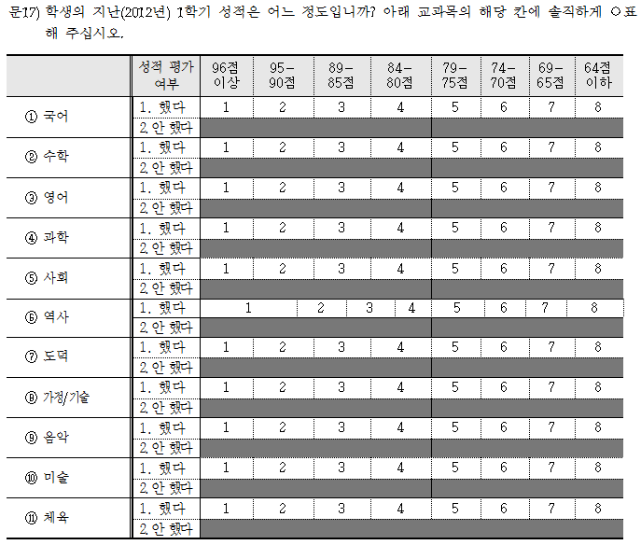

Slide 8
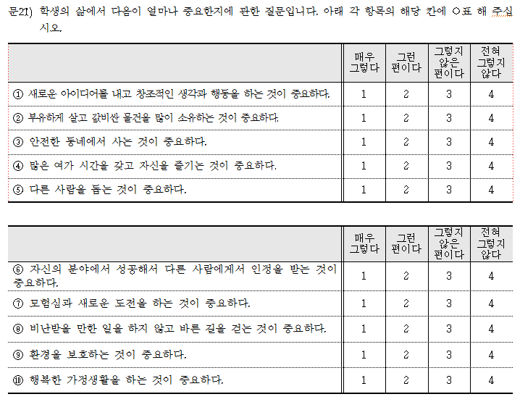
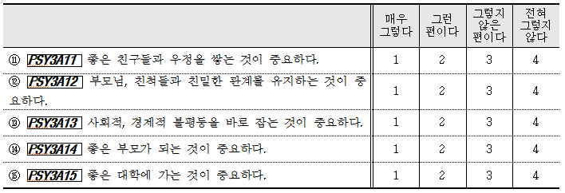

Slide 9
[2. Youngjoon Bae] "Why Is Korean Girls’ Suicidal Ideation Rate Higher than Boys’ Rate? An Approach from Structural Peer Characteristics"
Important and interesting question with a unique data!
Would be helpful to provide a histogram to show a distribution of number of friends and also listed friends
Hard to construct a reliable measure and hard to interpret
“If a person had friends only consisting of the same gender to him/her, the person was coded as 1 in “same-gender friends”. In this manner, “similar-class friends” and “similar-grades friends” were constructed.”
For boys, {M,M,M,M,M,M,M} = 1, but {M,M,M,M,M,M,F}=0 & {M,F ,F ,F ,F ,F,F}=0 {M,M,M}=1 {M,F}=0
Class and grade as three groups (reported by a respondent)
(Friendship network - Unidirectional or Reciprocal?)
Notes:
Base model: 3061, cluster model: 2534

Slide 10
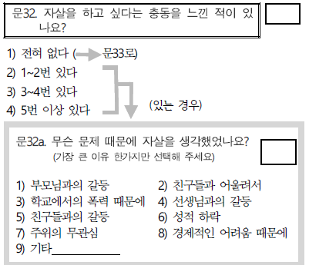
Any school characteristics: coed school or coed class → It matters for gender composition of friends)
Suicidal ideation motivated by conflict with parents? (as a main reason!) → Would be good to have more arguments to link suicidal ideation due to conflict with parents and role of friendship
To check sensitivity using other waves if time permits

Slide 11
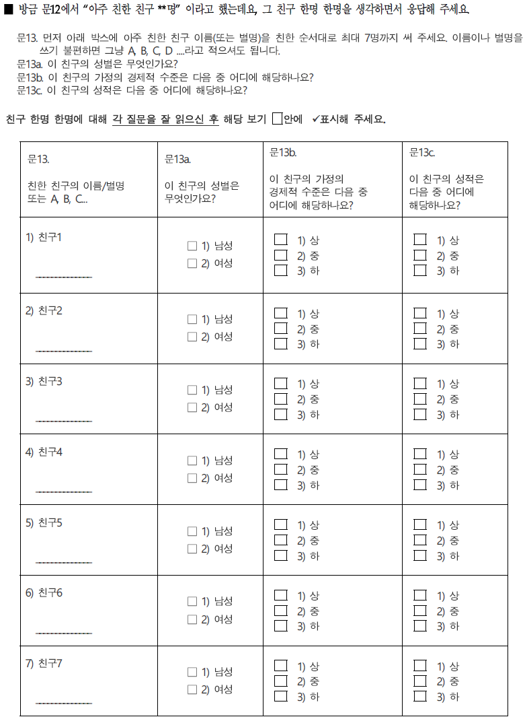

Slide 12
[3. Zhiyong Lin & Jaein Lee] "Changing Attitudes Toward Homosexuality in South Korea, 1996-2010"
Well polished paper, very easy to read
(Although sample would be small), it may be worthwhile to estimate the same model for each year: any trends?
Acceptance of homosexuality: 20's in 1996 vs. 30's in 2005, 20's in 2001 vs. 30's in 2010
Overall increase in the acceptance in the homosexuality, which is captured by year FE. Why?
Additional wave of WVS for the recent cohort or Other data sets to cover more recent periods? (in addition to KGSS 2008, 2012)
Notes:
Calculate marginal effect and see what proportion of the increase can be explained by each covariate

Slide 13
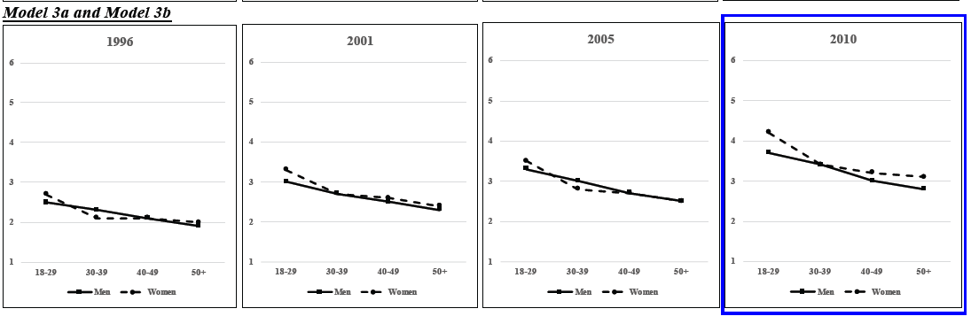
True? May need a formal test “Furthermore, gender differences in acceptance of homosexuality, which is often suggested that women are more liberal in controversial social issues like homosexuality than men, is only prominent among the younger generation in South Korea”
Way of (causal?) interpretation: "Comparing coefficients of age group and survey year across models, our results have shown that sociodemographic characteristics and traditional attitudes on family, gender, and marriage can explain most of the generational gap in acceptance of homosexuality and some of its changes across years. In other words, older adults are more conservative in homosexuality compared to young people, mostly due to their less educational attainment, higher level of religiosity, and traditional attitudes toward family, gender, and marriage.”
Notes:
Anything to mention from regression results about control variables: quality of social relationships, family backgrounds

